Slide 1


SMART INDIA HACKATHON 2024
PASSIVE SINGLE AXIS SOLAR TRACKING
Problem Statement ID – SIH1545
Problem Statement Title- Development of a non-electrical device for tracking the movement of the sun for the movement of the solar panels, increasing their efficiency
Theme - Renewable / Sustainable Energy
PS Category- Hardware
Team ID- 7195
Team Name- EEE08

Slide 2
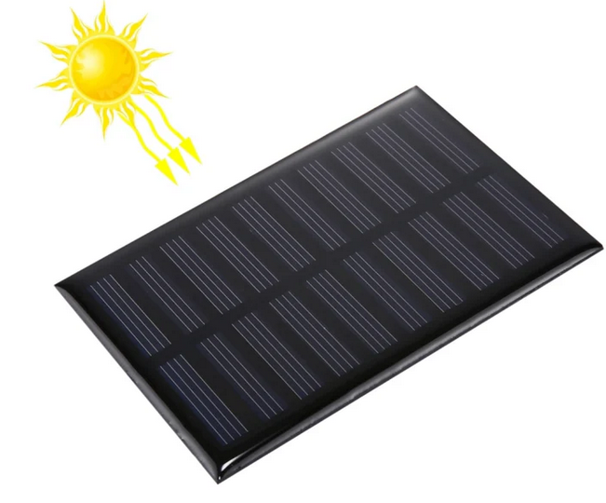
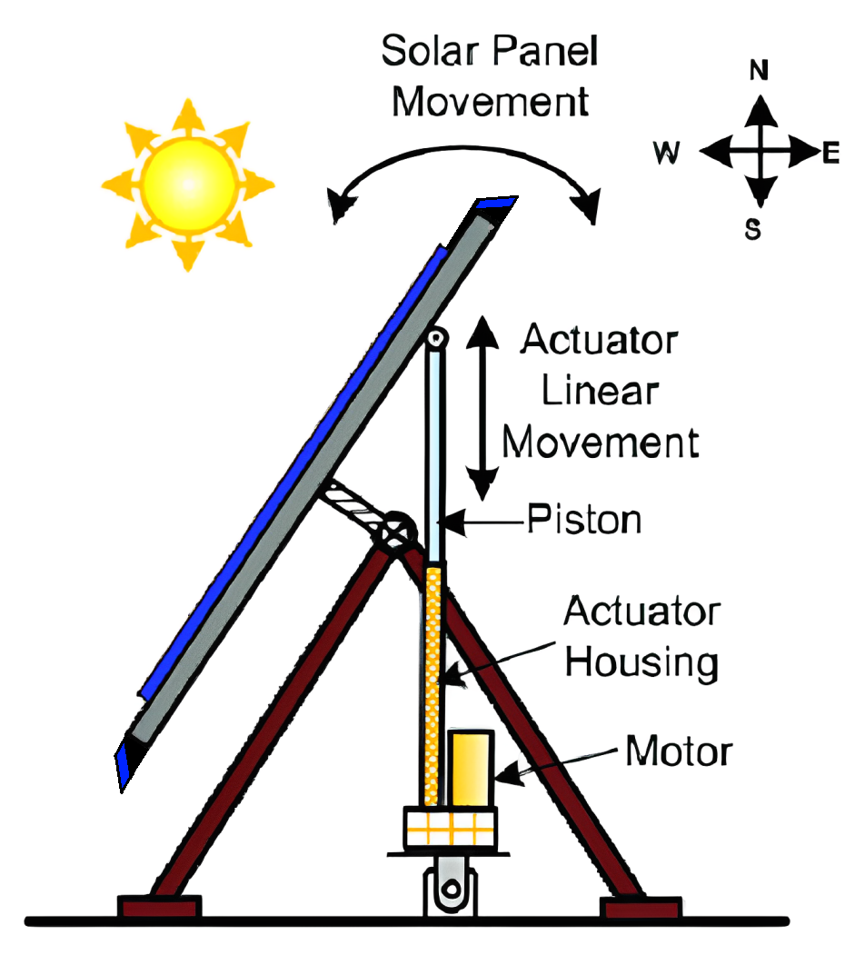
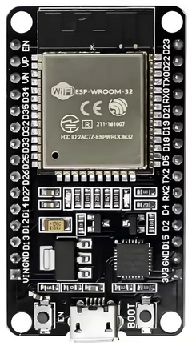
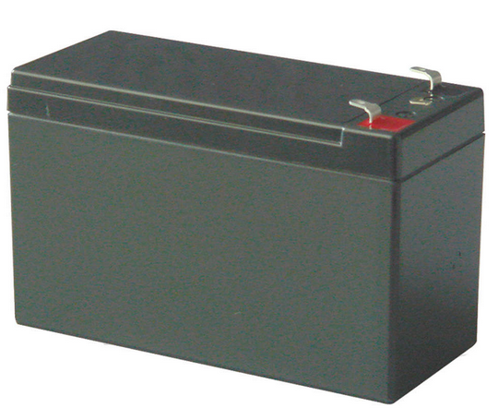
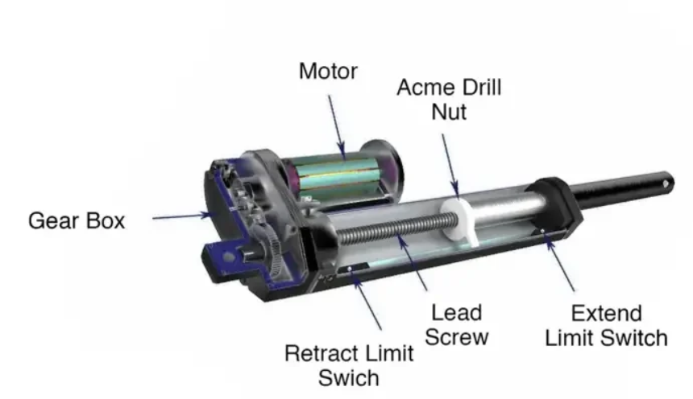
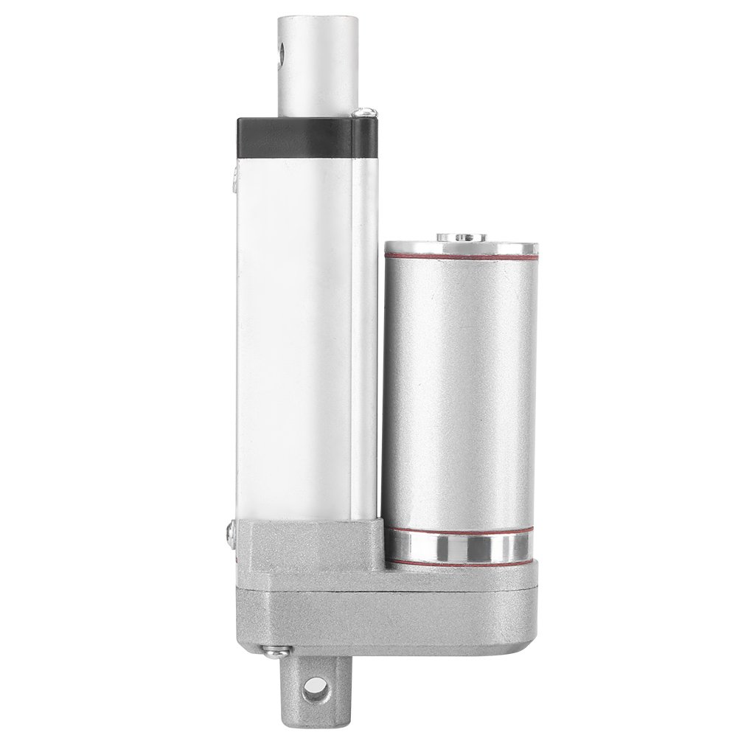
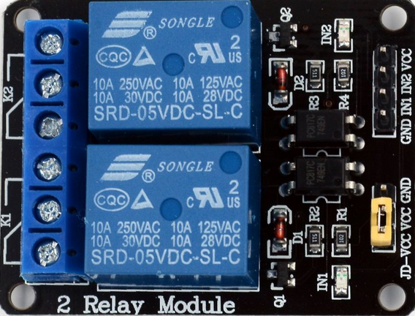
IDEA TITLE
EEE08
EAST PANEL
The idea is to develop a tracking system by using Additional Solar Panels for Maximum Exposer
Output of a side Solar panels signal is given as input to Microcontroller
The Microcontroller will reads signal from panel ,Based on that signal Relay will ON and OFF (Forward and Reversed)
On that signal from Relay Actuator will lift Accordingly
Also Battery is powered by side solar panels
MAIN PANEL
SOLAR PANEL-1
WEST PANEL
BATTERY
ACTUATOR SPECIFICATION:
SOLAR PANEL-2
MICRO CONTROLLER
ACTUATOR
RELAY MODULE

Slide 3
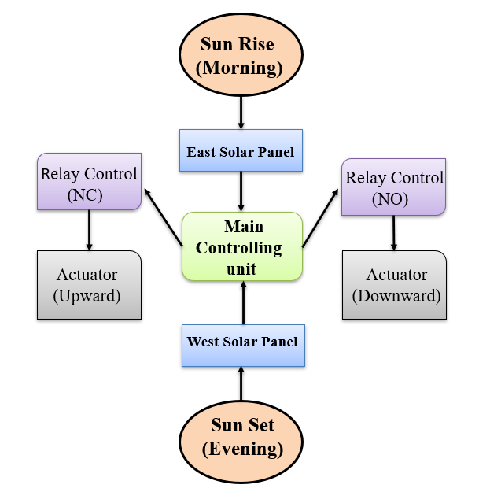
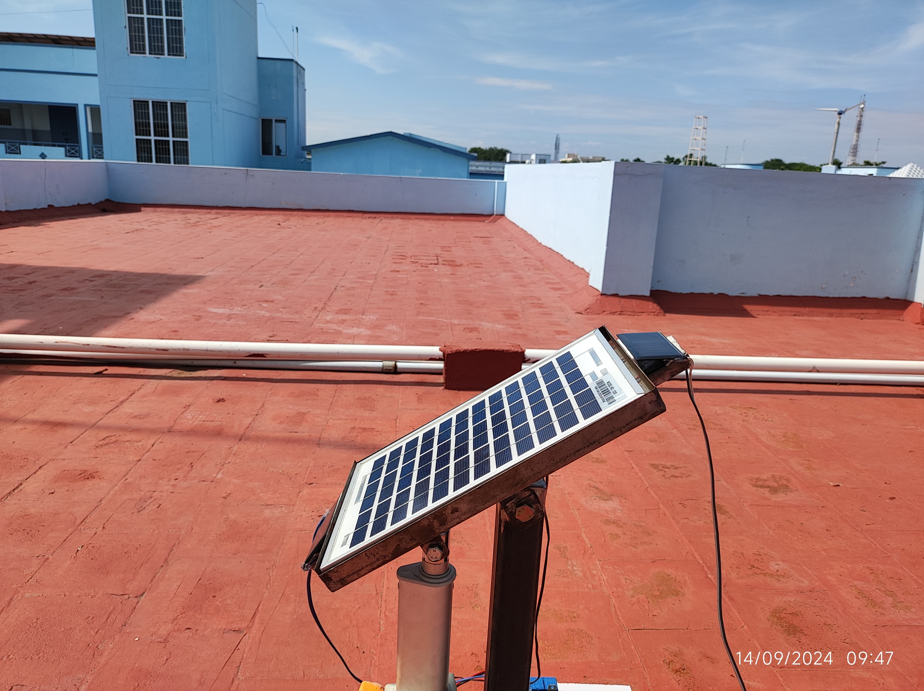
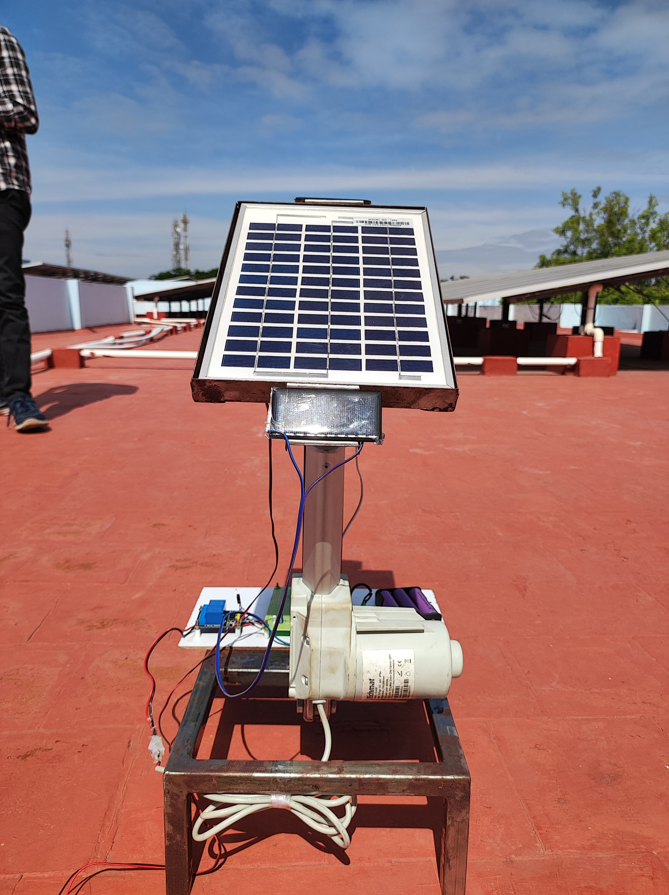
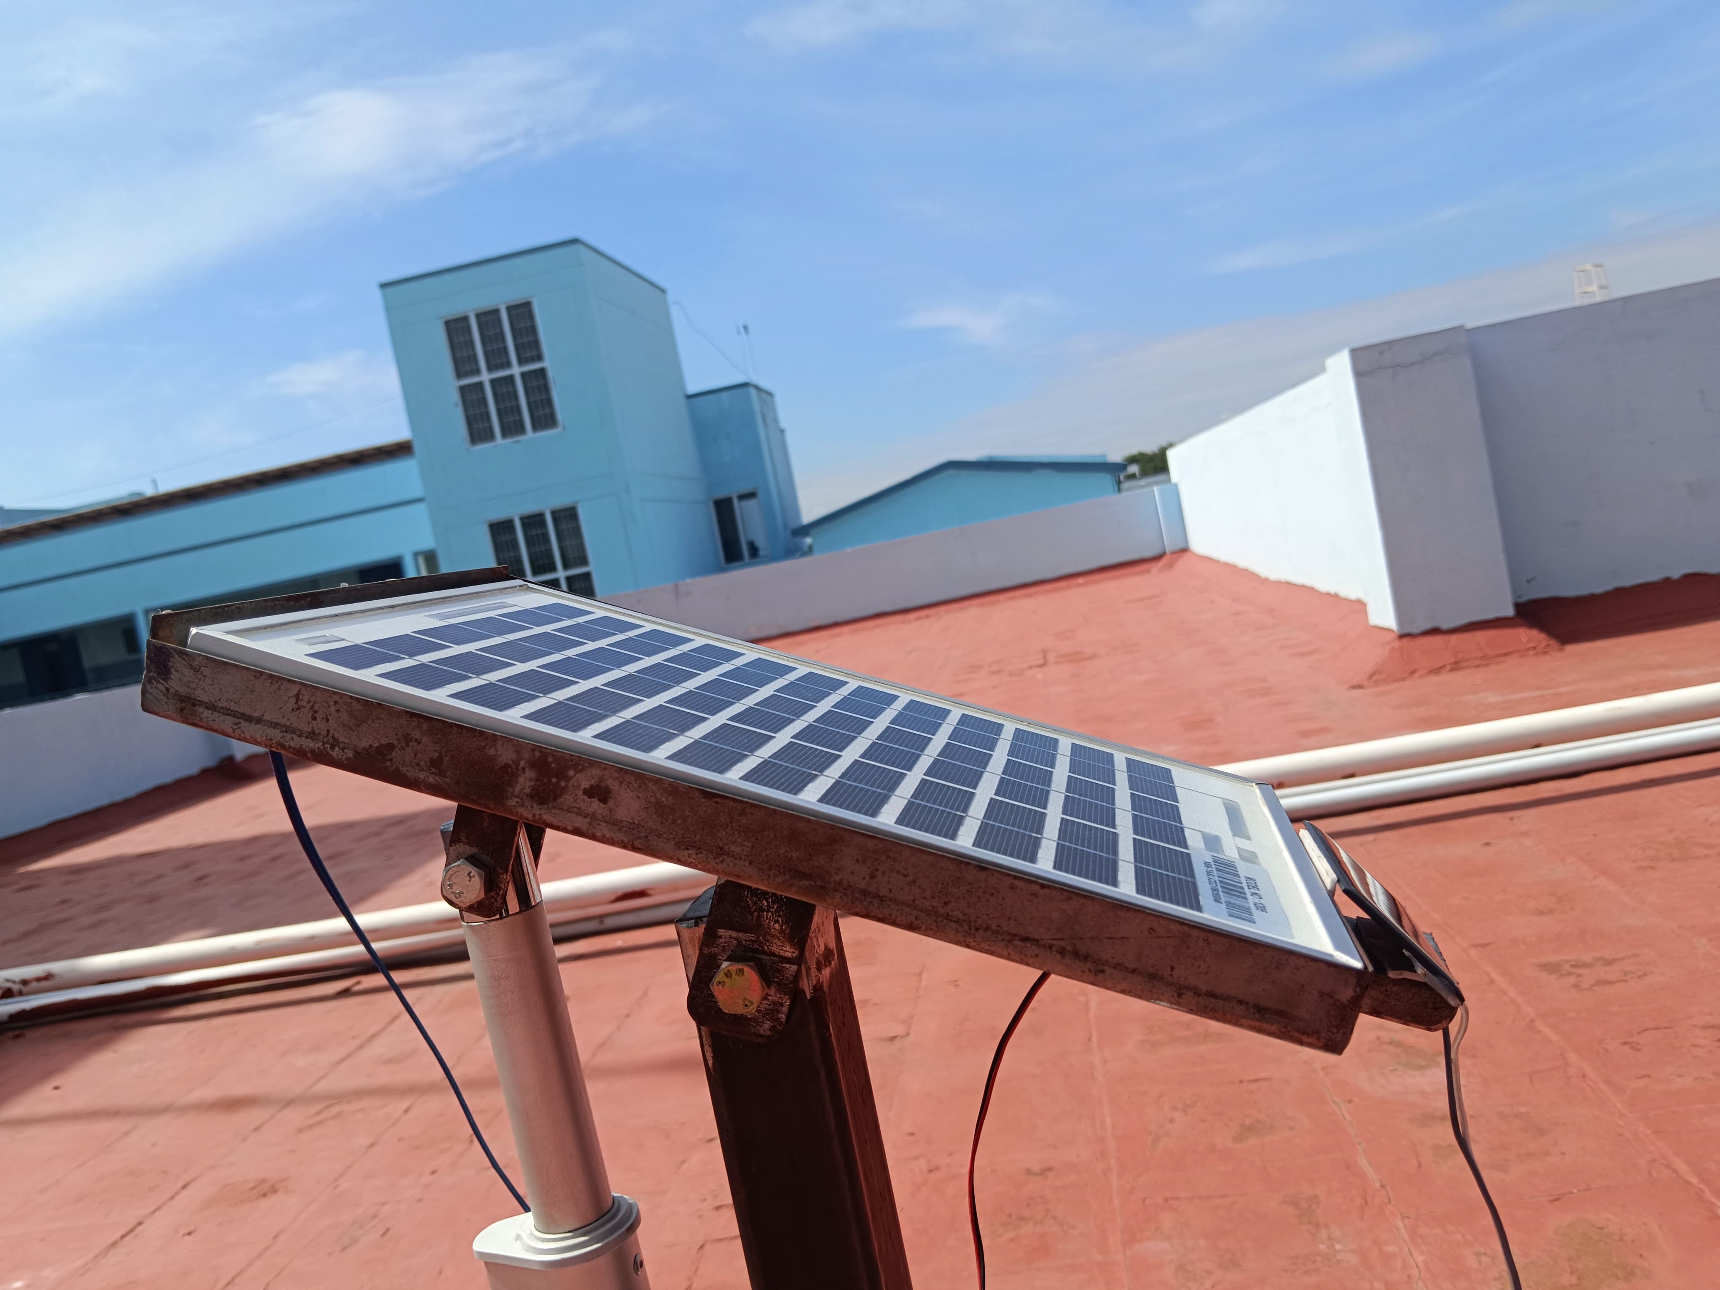
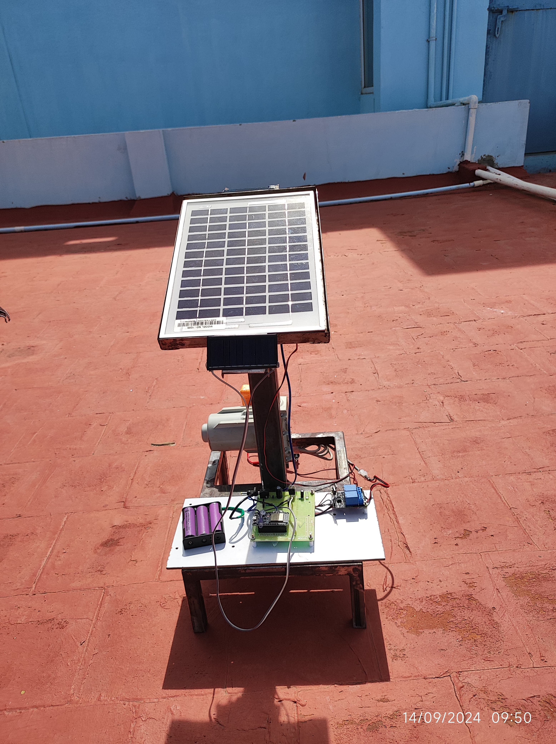








TECHNICAL APPROACH
EEE08
Working Model
Technology Stack:
linear actuator DC
Solar panels
Microcontroller(eg:ESP32)
Relay
Battery
Metallic mound stand
Programing(eg:Embedded C)
Block Diagram
(Morning)
(Evening)
Methodology:
Two small solar panels inclined 30 degree to main panel
Based on the voltage difference from side panel controller operates a relay
Relay will responsible for ON and OFF(forward and Reverse) the Actuator
The Actuator is connected to main panel and tilt the main panel for optimal Exposer
Product Status:90% product build completed further testing and validation test is need to be done

Slide 4
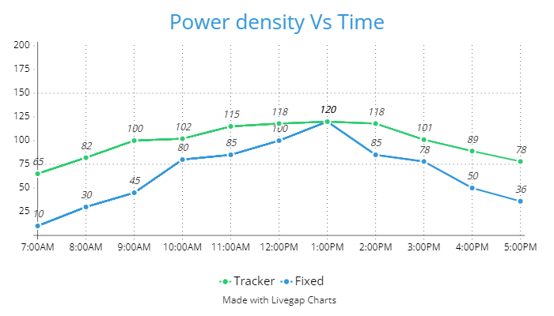
IMPACT AND BENEFITS
EEE08
S.No | Active solar tracker | Passive solar tracker
1. | Motor-driven | Self-adjusting
2. | Complex | Simple
3. | Advanced | Basic
4. | High Maintenance | Low Maintenance
5. | Power-consuming | Energy-efficient
6. | Precise | Less Precise
Potential impact:
Eco-Friendly: It has no noise and very safe
Space Requirement: When going for a moving system an additional space is Required
Initial Cost: Need cost for initial setup for tracking System
Life Span: It is more reliable and long-life
Benefits:
Higher Energy Output: Compare to Static Solar panels, Tracking system is more energy output
Maximum Return On Investment : When get more power and get more returns on that
Improved Grid stability: Stability of main panel is maintained, when both side have equal weight

Slide 5
FEASIBILITY AND VIABILITY
EEE08
FEASIBILITY:
Uses simple materials, making it budget-friendly to build.
Can be set up quickly with minimal technical knowledge.
Can be expanded or adjusted for larger solar setups.
VIABILITY:
Requires only occasional checks to ensure smooth
Designed to withstand outdoor conditions for long-term use.
Reduces reliance on external power, making it sustainable.
Conventional Solar Tracking System | Proposed Solar tracking system
High initial Cost | Comparatively Low
It consist of sensors, timers and works upon real-time data | It consist of solar panels For real-time sun direction
It depends temperature and weather | It depends on Sunlight
Suitable For ON-Grid system (Need Continues Power supply) | Suitable For OFF-Grid system (Doesn’t need continuous and Additional power supply)
Cost:-5000IND/W-DC | Cost:-3500IND/W-DC
POTENTIAL CHALLENGES AND RISKS:
May not track the sun effectively in very low light or cloudy conditions.
Requires proper setup for optimal functioning, which may take time.
Extreme weather conditions may affect its performance.
STRATEGIES FOR OVERCOMING THE CHALLENGES:
Frequent inspections to ensure the system stays accurate.
Easily upgradeable parts to improve efficiency over time
Can replace individual parts without redoing the entire setup.
5
@SIH Idea submission- Template

Slide 6
RESEARCH AND REFERENCES
EEE08
Chetan Singh Solanki (2015). “Solar Photovoltaics- Fundamentals, Technologies and Applications”. Department of Energy Science and Engineering, IIT,Bombay.
Guiha Li, Runsheng Tanf, Hao Zhong (2011). “Optical Performance of Horizontal Single-Axis Tracked Solar Panels”, Solar Energy Research Institute Yunnan Normal University,China.
Gama M Dousoky, Abou-Hashema, M ELSAYED, Masahito Shoyama (2011).“Maximizing Energy Efficiency In Single Axis Solar Tracker Photovoltaic Panels”. 8th International Conference on Power Electronic-ECCE Asia.
Rizk J. and Chaiko Y (2008). “Solar Tracking System: More Efficient Use of Solar Panels”, World Academy of Science, Engineering and Technology.
Imam Abadi, Adi Soeprijanto, Ali Musyafa (2015). “Design of Single Axis Tracking System at Photovoltaic Panel Using Fuzzy Logic Controller”, Department of Engineering Physics and Electrical Engineering, Sepuluh Nopember Institute of Technology, Surabaya.

